Slide 1

In the Shop

Slide 2

Read the transcription
|ˈblaʊz|, |skɑːf|, |skɜːt|, |ʃɜːt|, |ˈtiːʃɜːt| , |hæt|, |ʃɔːts|, |ˈswetə|,
|ɡlʌvz|, |buːts|, |ʃuːz|, |ˈkəʊt| ,
|dʒiːnz|, |ˈdʒækɪt| |ˈtraʊzəz|

Slide 3
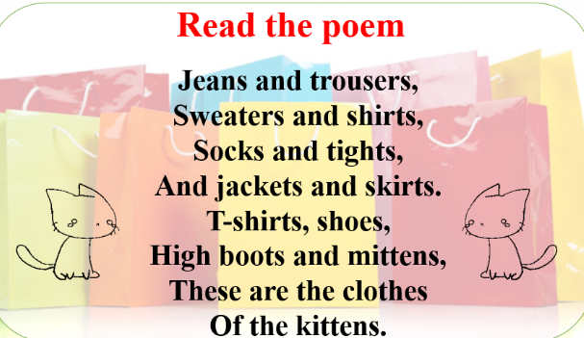

Slide 4
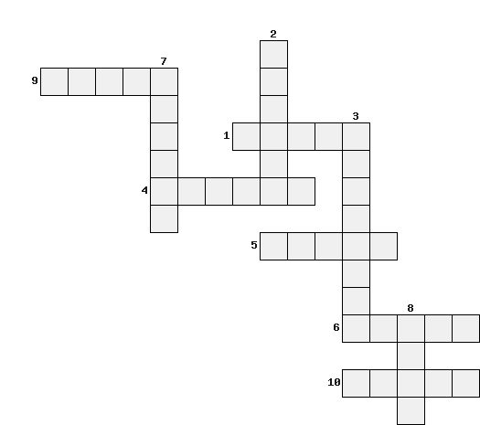

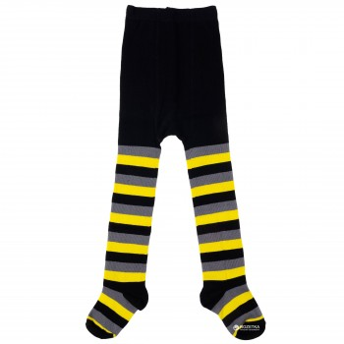

Crossword

Slide 5
Crossword
J
a
c
k
e
B o o t s
h
o
r
t
s
s
i r t
r
o
u
s
e
r
s
i g h t s
d r e
s
o c k s
o
a
t
s c
r f

Slide 6
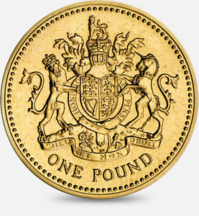
Crossword
0-1 mistakes
2-3 mistakes
4-5 mistakes

Slide 7
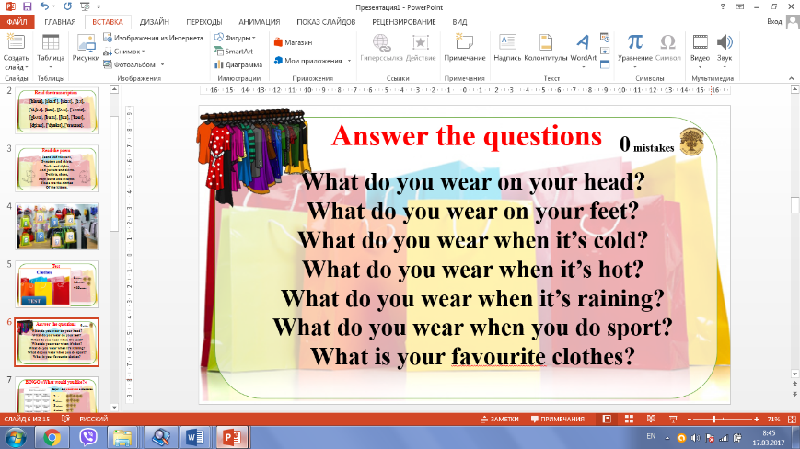

Slide 8
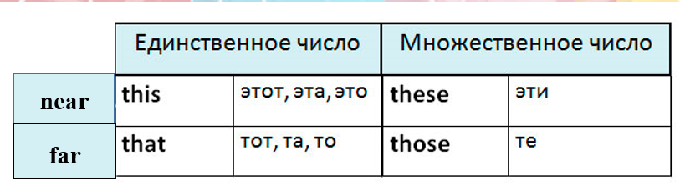
Demonstrative pronouns
(указательные местоимения)
WB ex 3 p 43

Slide 9
How much are they? How much is it?
WB ex 2 p 42

Slide 10
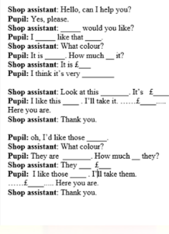

Let’s do the shopping
Listen and complete the sentences

Slide 11
READ
THE DIALOGUE
ROLE PLAY
THE DIALOGUE

Slide 12
BEsT change
10
9
8
10-11
9-8
7
7
6
5
6
5
4

Slide 13
Homework
What mark do you want to have?
7 – WB ex 1a p 42
8 -WB ex1a, ex2 p 42
9 - PB ex 2c p50 (make up a dialogue)
10 - PB ex 2c p50 (represent your dialogue)

